Slide 1


Introduction TO R
Simon Ress
Faculty of Social Science
Chair of Social Science Data Analysis & Chair of Comparative Political Science

Slide 2
What is R?
R is a comprehensive statistical environment and programming language for professional data analysis and graphical display
It is a GNU project which is similar to the S language and environment which was developed at Bell Laboratories
Webpage: http://www.r-project.org
Advantages:
R is free
It runs on a variety of platforms including Windows, Unix and MacOS.
New statistical methods are usually first implemented in R
It has state-of-the-art graphics capabilities
Lots of help due to collaborative project
Disdvantages:
R has a steep learning curve

Slide 3
What is RStudio?
Powerful IDE (integrated development environment) for R
Some features:
Tab-completion of filenames, function names and arguments
Full-featured text editor (e.g. syntax highlighting, parenthesis and bracket matching, find/replace with regular expressions)
The graphical workspace
Seamless integration of Rmarkdown, knitr, GIT and other development tools
Its free and open source, and works on Windows, Mac, and Linux and over the web.
Webpage: https://www.rstudio.com/

Slide 4
Interaction between R and RStudio
Before you can ask your computer to save some numbers, you’ll need to know how to talk to it
That’s where R and RStudio come in
RStudio gives you a way to talk to your computer
R gives you a language to speak in
Usually, you don't interact with R directly, you just have to have it installed
To get started, open RStudio just as you would open any other application on your computer
WHEN DO WE COMPILE?
In some languages, like C, Java, and FORTRAN, you have to compile your human-readable code into machine-readable code (often 1s and 0s) before you can run it
If you’ve programmed in such a language before, you may wonder whether you have to compile your R code before you can use it.
The answer is no. R is a dynamic programming language, which means R automatically interprets your code as you run it.

Slide 5
Typical workflow
Open Rstudio
Open a new or pre-existing script in Rstudio (extension .R)
Set working directory with setwd("path2directory")
Load (and install) required libraries Install with install.packages("name") - only once need to specify CRAN mirror Load with library(name) - each session if required
Comment your script with # really important
Write and execute your commands
Two options for execution:
Button: “Run”
Keyboard shortcut: “Ctrl”(german keyboard:“Strg”) + “Enter”
Save outputs in your working directory (or specify another folder)
Save changes to your R-script
Button: „Save current document“
Keyboard shortcut: “Ctrl”(german keyboard:“Strg”) + “S”

Slide 6
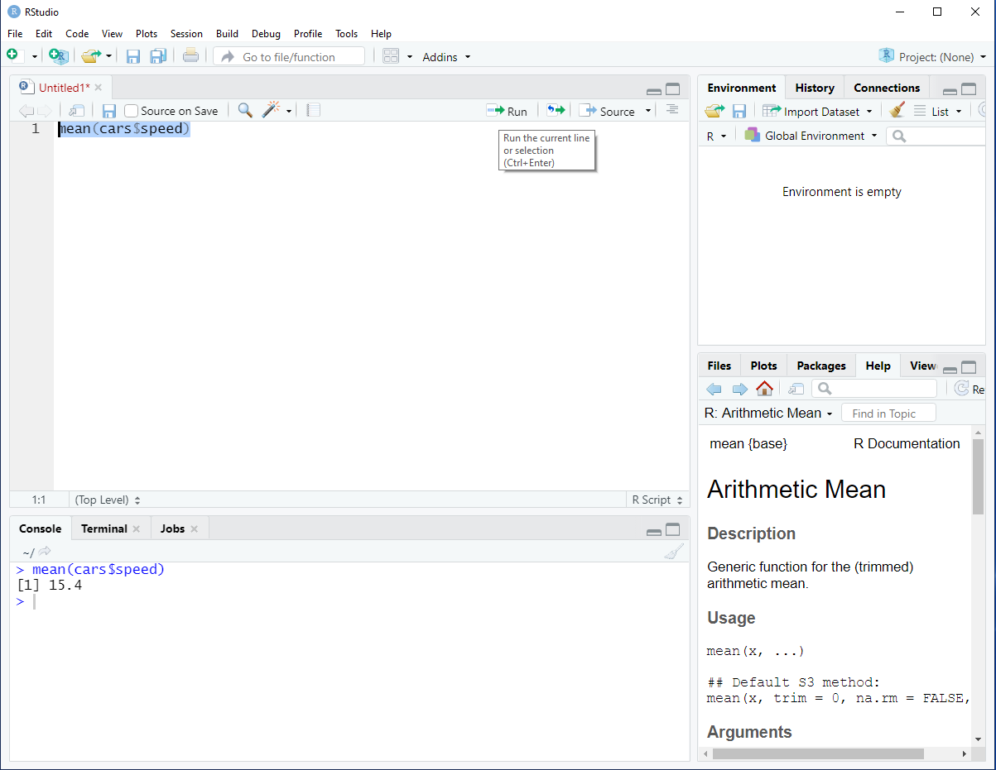
R-Script
(Commands are written here)
Run current line or marked section
Save
current
R-Script
Environment
(see datasets,
vectors,
functions, …)
Console
(Results of executed code & alternative for executing commands)
Multifunctional panel
(See files within working directory, plots, …)

Slide 7
Information on notation
Commands are always represented one-to-one in the way they are written. Words within <> mean that something has to be written at this point without the <>.
For example, the abstract representation of the help(<command>) command in R would be applied like this: help(mean)

Slide 8
Getting help
Several ways to get help for arising problems
Using in-R documentation by typing help(<command>) or ?<command>
Searching for help on stackoverflow
Using a web search engine („R …..“)

Slide 9
Contact
Published by
Simon Ress
Ruhr-Universität Bochum
Faculty of Social Science
Chair of Social Science Data Analysis & Chair of Comparative Political Science
Phone: +49(0)234 32 - 19672
E-Mail: Simon.Ress@rub.de

